Slide 1
‘Agile with SCRUM’ – Scrum Master’s workshop
Sriram Balasubramanian

Slide 2
Agenda / Objectives
Agile Software Development - Introduction
Agile Process Framework
Agile Delivery and Deliverables - Techniques and Best Practices

Slide 3
Agile Software Development – What?
”Agile is an umbrella term used to encompass dozens of different techniques and disciplines (e.g. Scrum, XP, KANBAN, etc.), all aimed at the iterative, incremental development of software.
Agile is about
Collaborative working with Business, Technology and Vendor Partners
Iterative, incremental development
Value Driven Development
Regular delivery of Minimum Marketable Features
Continuous prioritization of requirements
Agile is NOT about
Immediate Savings
Work performed by motivated, self-organizing teams
Replacement for Waterfall
Easy to Implement
Delivering before time
Agile boosts Stakeholder Confidence and Employee Satisfaction / Morale
Taking controls away – scope etc.
Cutting Corners
Agile doesn’t guarantee success – it increases the Likelihood of Success

Slide 4
Agile Software Development – Who?
Business
Success of Agile Software Development lies not only with one entity
Success lies in all the three entities coming together and working in close collaboration
It’s a whole team model rather than Us vs. They
Success or Failure of the project depends on the whole team
Technology
Partners

Slide 5
Agile Iron Triangle
Agile will require a fundamental shift for AET and the Business.
In an Agile project, requirements change throughout the project life cycle, in contrast to traditional waterfall projects, where requirements are fully defined at the beginning with intentions to keep them static throughout the project
Requirements (Scope)
Fixed
Time
Resources (Cost)
Value Driven
Plan Driven
Time
Resources (Cost)
Variable
Requirements (Scope)
Requirements are fully specified and fixed
Time to develop solution is projected
Resources vary to reduce cycle time
Requirements specified at high level & prioritize and evolve as project progress
Time boxed development
Resources fixed & managed to deliver at estimated costs
The flexible management of prioritized business requirements is the key to achieving delivery results that meet business needs for the estimated cost

Slide 6
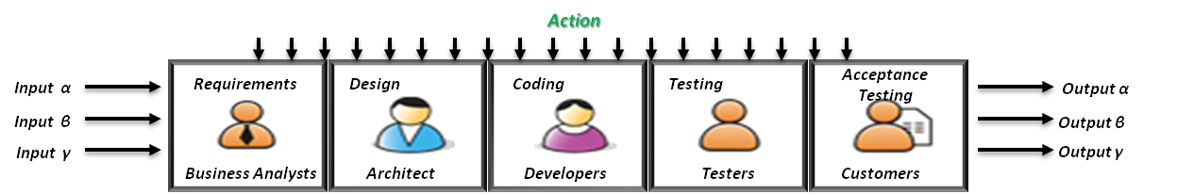





Standing Team – From Project Culture to Team Culture
Become a function with focus on addressing a broader array of erratic project demand challenges and support long-term growth objectives. (i.e., a complete customer-centric feature, across all components and disciplines).
EXISTING
Team ramp-up and ramp-down as project progress
Team dismantled after project completion
The visibility for any role is restricted only to the stage where they play a primary role
TRANSITION TO
LONG LIVED STANDING TEAM
Continuously working on backlog of work items and not on any projects)
Self Organizing, Cross functional team members
High visibility on project progress to all team members
Collaborative ways of working
Frequent Delivery
Input β
Output β
What it means:- Bring projects to Agile team rather than bringing teams to the project.

Slide 7
Manifesto for Agile Software Development
We are uncovering better ways of developing software by doing it and helping others do it. Through this work we have come to value:
Individuals and interactions over processes and tools Working software over comprehensive documentation Customer collaboration over contract negotiation Responding to change over following a plan
That is, while there is value in the items on the right, we value the items on the left more.

Slide 8
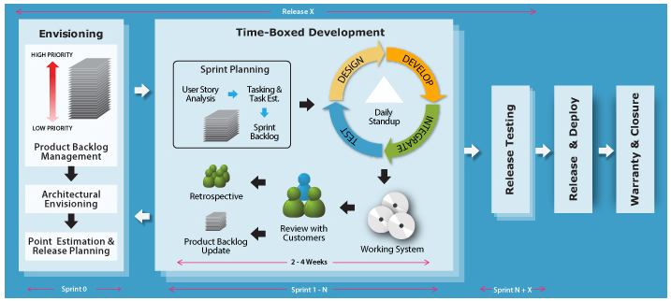
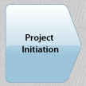
Agile Process Framework

Slide 9


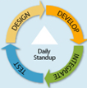
Agile Process Framework Contd…
C
Core + Extended Team
End Users or User Group
Core Team
Iteration Backlog
High Priority groomed work items
Provides Ideas
Part I – User Story Analysis
Part II – Tasking and Task Estimation
PO
Creates Initial Product Backlog
Product Owner/ Chief PO
Backlog Grooming
S
5 – 10% of the Iteration Capacity is dedicated to Continuous Backlog Grooming i.e. Story Analysis, Point Estimation and Splitting stories
PO
Scrum Master
T
Product Owner
Core Team
Extended Team
Core + Extended + Stakeholders
Core Team
Backlog Grooming and Architecture Envisioning
(i.e. Splitting Stories, Point Estimation, Analyzing the Stories, etc)
Product Backlog
Iteration 0
Retrospective
Product Review – Show and Tell
Iteration 1 - n
Release Testing
Release Testing
Release Testing

Slide 10
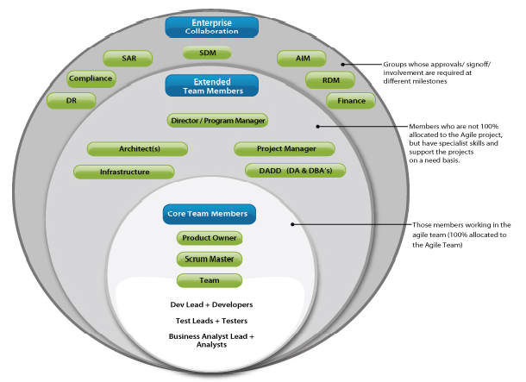
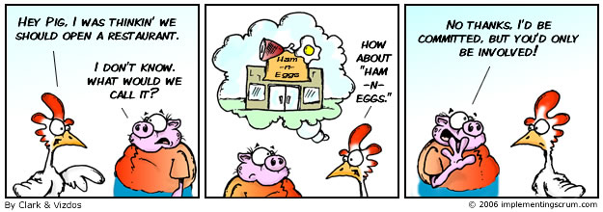
Agile Process Framework - Roles
Roles in Agile Software Development are classified into three core roles (also known as the Core Team Members and a range of ancillary roles (also known as Extended team and Enterprise collaboration)—core roles are often referred to as pigs and ancillary roles as chickens.
Graphic represents dedicated agile team roles (Core Team Members) in the inner circle with the supporting team roles (Extended Team Members) in the middle circle and Enterprise Collaboration in the outer circle
Extended members may at times be assigned to the core team thus making them core team members

Slide 11
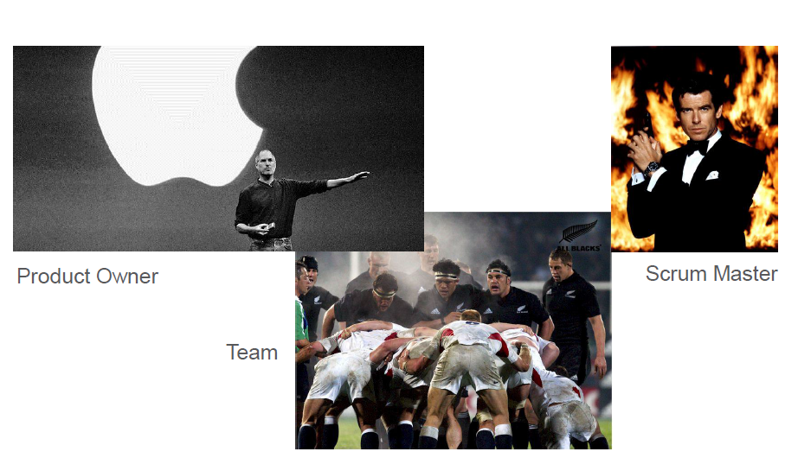
A simple Framework to manage the complex projects

Slide 12
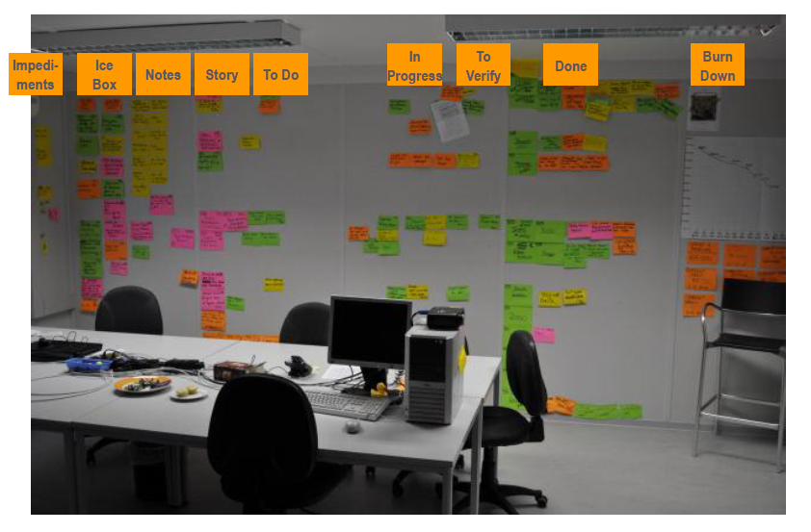
Agile with Scrum On Wall

Slide 13
The Role of the Product Owner
Who plays the role?
The Product Owner role is played by the Business
What are the role expectations?
Core Team member
Knowledge of the product domain
Vision and roadmap for the product
Empowered to make decisions and tradeoffs
Available and willing to participate in process, to achieve maximum ROI
Activities
Identify the high level Product Backlog User Stories Prioritize the User Stories Actively participate in the release planning and owns it Explain the functionality of each User Story Understand and support the Agile method Assess the incremental and end product | Prepared to make improvement changes early if necessary Conscious of the time box once a Iteration is started Adjust User Story priority based on new information Work with other Product Owner to ensure priority alignment Obtain business senior management agreement on scope, cost, and date

Slide 14
Agile process Framework – Product Owner Contd…
A typical time commitment from Product Owner
Activity | Duration | Business Commitment to Agile Project Team*
Initiation (Defining & Planning) | 3 + Weeks | Product Owner = 80% -100%
 |  | Product Owner needs to have product expertise, responsibility for coordinating with others and making decisions. Charter and Backlog is created.
Project Kick-Off | 4 hours | Product Owner = 100%
 |  | Product Owner provides project scope details and share backlog with the team.
Iteration 0 / Release Planning | 2 weeks | Product Owner = 50% - 80%
 |  | Product Ower must make themselves available and give the highest priority to the clarification of the backlog items and the approval of the Release Plan. It should be their primary work assignment.
Iteration 1 - N | 2, 3 or 4 weeks | Product Owner = 25- 50%
 |  | Must be the highest priority on their daily work assignments. A quick response on any questions or clarification must be promptly.
Daily meetings | 15 mintues | Product Owner = 100%
 |  | Product Owner communicates progress on tasks assigned to them, get updated on team progress against the plan and known impediment.
Iteration Planning | 2-4 hours | Product Owner = 100%
 |  | Product Owner "Must" be present to articulate to the team details of the items that are in the backlog for the Iteration. A ddelegate is NOT accepted.
Show & Tell | 2-4 hours | Product Owner = 100%
 |  | Product Owner "Must" be present. This ceremony is for the Team to demonstrate to the Product Owner the items that were inlcuded in the Iteration. This ceremony "cannot" take place without the PO. A delegate is NOT accepted.
Retrospective | 1 hour | Product Owner = 100%
 |  | Product Owner works with the team to discuss and document what went well and what can be improve for subsequent Iterations.
Iteration Testing | 2 weeks | Product Owner = 5%- 20%
 |  | Product Owner respond to questions and clarification promtly.
Release Testing / UAT | 1 week | Product Owner = 80% - 100%
 |  | Coordiante and support the UAT activities.
Deployment | 1 week | Product Owner = 80% - 100%
 |  | Validate results.
* The Product Owner should be 100% dedicated to the project, however this document represent the % of time that is required to interact with the Agile Project Team for each one of the Agile Phases.

Slide 15
The Role of the Scrum Master
Who plays the role?
Anyone can play the role, but with a different mindset
What are the role expectations?
Servant Leader to the team members
Shield team from interruptions
Remove impediments to progress
Re-Communicate project vision
Carry Food and Water
Assist the core team members and product owner in removing Impediments that obstruct a team’s pursuit of its Iteration goal
Assist the core team members and product owner in following the agile practices
Participate in story point estimation
Commit to the release plan
Empowering and shepherding the team
Does everything to help facilitate team productivity

Slide 16
Team Member Role
Who constitutes the team?
Team members can be developers, testers, analysts, architects, technical writers, designers, and even users
The team is cross-functional, which means that between all its members they possess sufficient skills to do the work.
What are the role expectations?
Estimate the size of the backlog items
Participate in planning
Commit to the release plan
Track own progress
Is self-organizing – but accountable to the Product Owner for delivering as promised

Slide 17
Agile Deliverables
PROCESS
Project Vision
Business Alignment
Product Owner Selection
Funding
Agile Training
OUTPUTS
Project Charter
Product Backlog
Release Plan
Test Strategy
Solution Architecture
Security Interaction
Iteration Backlog
Working Code!
SIT Test Scripts and Cases
Test Scripts & Cases
Project Performance Rpt

Slide 18
Project Initiation

Slide 19
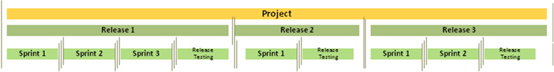
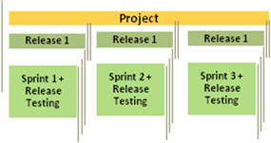
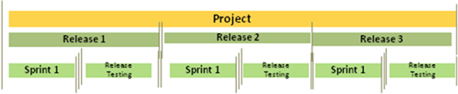
Project Initiation Contd…
Project
A project can have multiple releases and each release is a sub project within Clarity
Release 1
Release N
A Release can have multiple 2- 4 Week Iterations
Iteration 1
Iteration N
Iteration N
Scenario 1
Scenario 2
Scenario 3

Slide 20
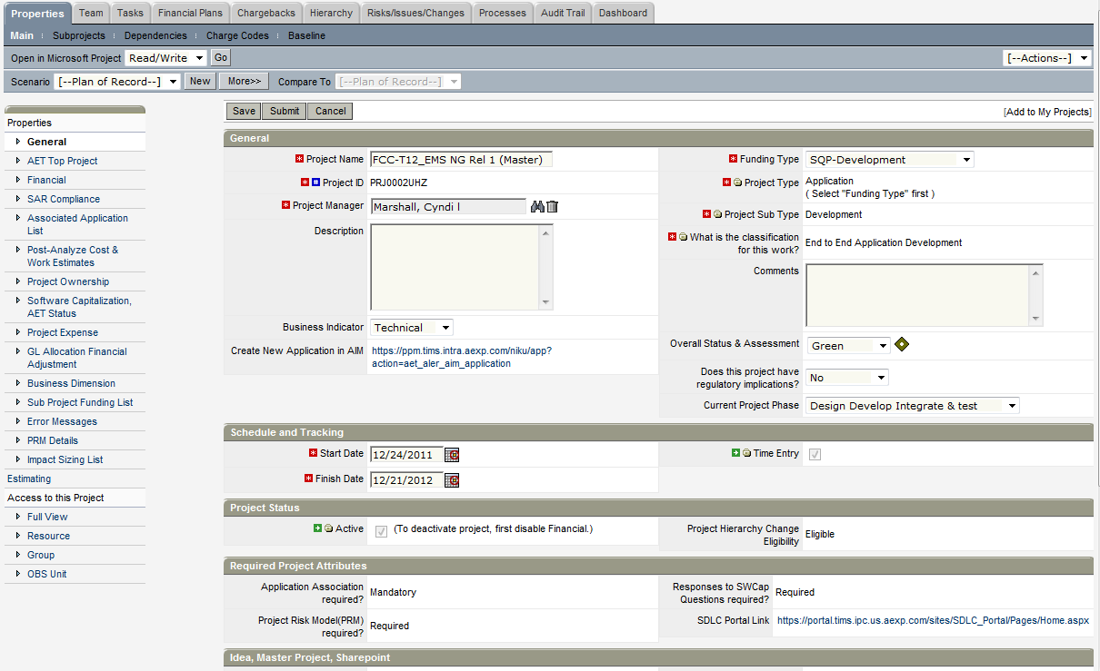
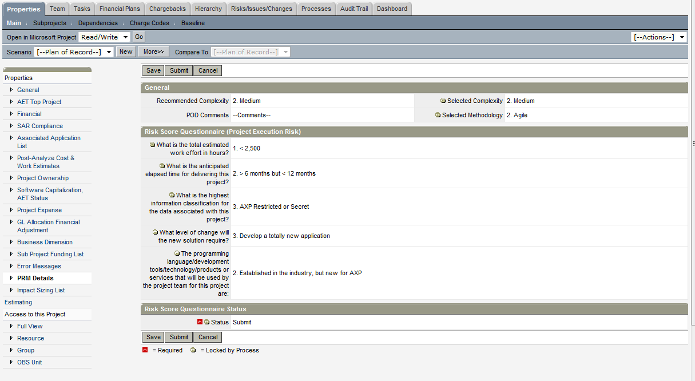
Project Initiation Contd…
Create the project in PMT (Clarity) with:
Project Type – Application
Project Sub Type – Development
Work Classification – End to End Application Development
Select Methodology - Agile

Slide 21
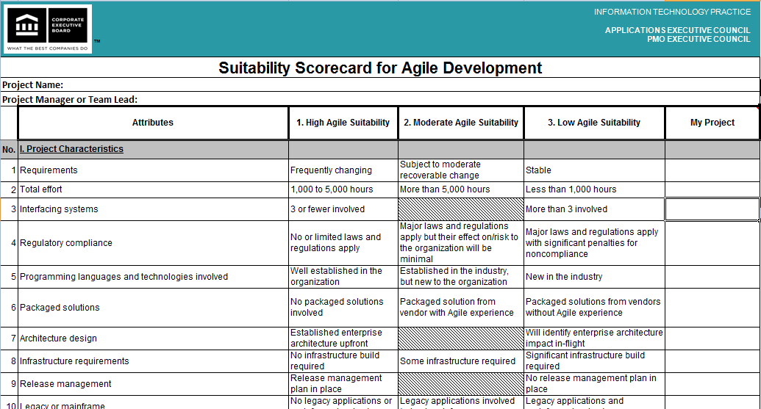
Project Initiation Contd…
Complete the Suitability Scorecard for Agile Development
Determine mitigation for attributes that score on “Low Agile Suitability”

Slide 22
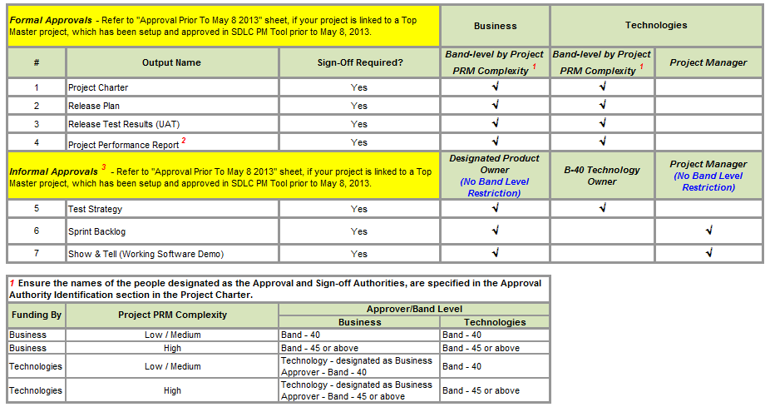
Project Initiation Contd…
Create the Project Charter
Signoff the Project Charter as per SDLC Compliance Approval and Signoff Authority Matrix

Slide 23
Envisioning

Slide 24
Envisioning
C
End Users or User Group
Provides Ideas
PO
Product Owner/ Chief PO
Creates Initial Product Backlog
PO
S
T
Product Owner
Scrum Master
Core Team
Extended Team
Backlog Grooming and Architecture Envisioning
(i.e. Splitting Stories, Point Estimation, Analyzing the Stories, etc)
Product Backlog
Iteration 0

Slide 25
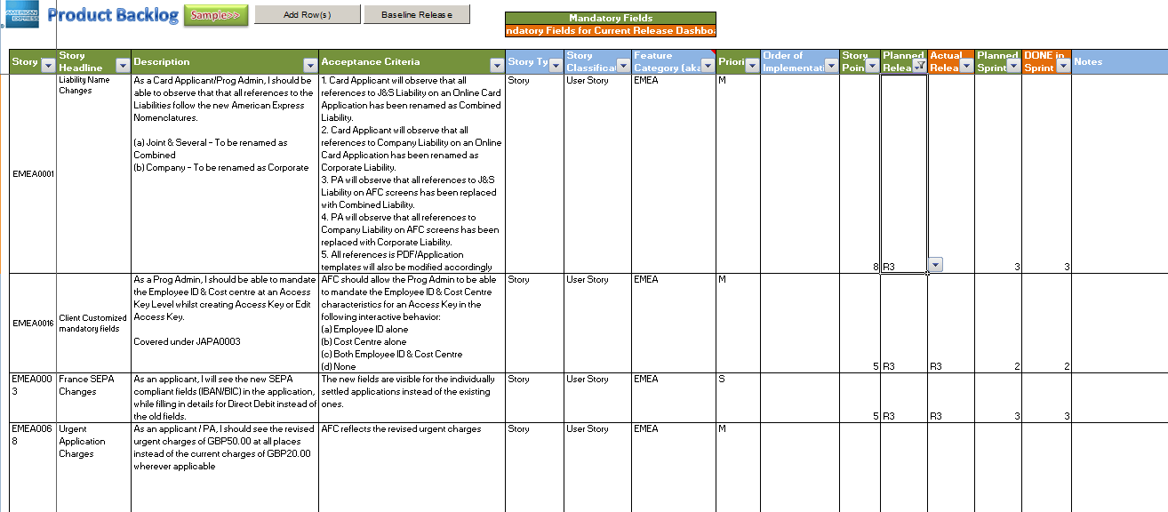
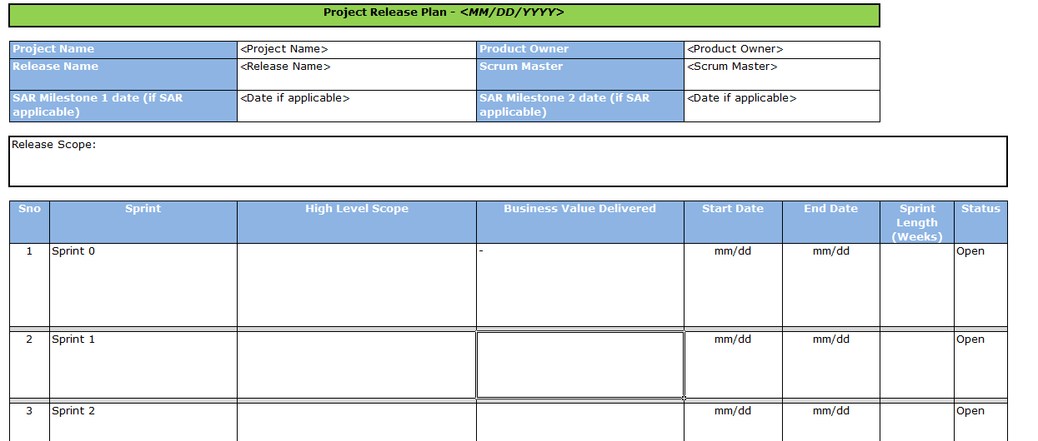
Envisioning Deliverables
Product Backlog
Release Plan
Test Strategy
Architecture and Design (SAD, SID)
Any additional documentation as determined by the team

Slide 26
Envisioning Sign off
Sign off on
Release Plan (Business and Tech)
Test Strategy (Business and Tech)

Slide 27
The 5 Levels of Planning
PLAN & COMMUNICATE
Project Charter Determines the project objective, stakeholder, budget, success factors.
Product Backlog Determines the project roadmap – provides the connection from vision to multiple release.
Product Backlog and Release Plan Determines how we release value incrementally? What subset of business objectives will each release achieve?
PLAN , COMMUNICATE & COMMIT
Iteration Backlog Determines and estimates tasks in ideal hours.
PLAN & COMMIT
Burn down chart Daily planning and tracking Iteration progress.

Slide 28
Understanding Progressive Elaboration
Is the process of adding more details as information emerges.
HOW DOES IT WORK?
At the beginning of the project we plan and estimate how big the endeavor is to create a reasonable strategy and execution approach.
We continually refine our plans as the project progresses and new details emerge.
Iteration 1 - N
WHY DO WE NEED IT?
Iteration 0
Release Test
Iterations
We use progressive elaboration to evolve and create increasingly accurate plans, estimates, User Stories, etc.
Now
Start of the project
Iteration 1 - N
Tips
Iteration 0
Release Test
Don’t limit the planning to the start of the project when very little is know about the project.
Iterations
Now
Project in 3rd Iteration
Notes:
Figure 1 indicates we are start of the project and creating the upfront plans. The lines in the iteration shows details. If you notice the initial iteration have lot of details and less details in subsequent iterations
Figure 2 indicates that we are in the 3rd iteration, the 4th iteration is planned in details while subsequent iterations are decreasing level of details.

Slide 29
Product Backlog
A Product backlog is simply a prioritized list of all work items, classified as
Stories | Prioritized list of project requirements with estimates (in Story Points) to turn them into completed product functionality
Technical debts | Other items like engineering improvement goals, exploratory or research work and possible known defects with appropriate estimate.
Risks | Risks that are of anti-value, or factors that have a potential to erode, remove, or reduce value if they occur.
Fine-grained Backlog Items ready for next Iterations/ Iterations i.e. smaller user stories
High priority
Each iteration implement the highest priority requirements
Each new requirement is prioritized and added to the stack
Stories are classified as Epic and User Stories (i.e. bite-sized) based on priority and level of details available.
Stories and Epics can be bundled together to form theme.
Medium-grained Backlog Items for current Release
Requirements may be reprioritized at any time
Coarse-grained Backlog items for Future Releases i.e. Epics
Requirements may be removed at any time
Low priority
Notes:
Grooming the product backlog
Sorted by priority with bite size stories at the top
Bottom of backlog contains epics or themes, that need to be broken down further into user stories
User stories can come from any of the team members, and it is the job of the product owner to prioritize the stories
The user stories are sized and estimated for level of effort and then the team works together to decide which stories will be included in the upcoming Iteration.

Slide 30
How do we determine the priority?
Customer value prioritization is concerned with working on the items that yield the highest value to the customer as soon as possible.
MoSCoW is a technique used to prioritize stories into four distinct categories:
M - MUST have this Requirements that are fundamental to the system; without which system will not work and have no value and have to be included in the current delivery timebox
S - SHOULD have this Requirements that is important for project success; Important as MUST have but not as time-critical or have a workarounds. In other words not necessary for delivery in the current delivery timebox
C - COULD have this Requirements not necessary; can include if it increases customer satisfaction for little development cost
W - WON'T have this time, but WOULD like in the future Alternatively WANT – No to this release

Slide 31
User Story
WHAT IS A USER STORY?
A specific need for a new feature/change on an existing/new program and/or system from a user’s perspective.
Widely used format for describing features on the Product Backlog
Short, plain-language descriptions of the feature, centered on the consumer of the feature, what they need it to do, and why i.e. Who does What and Why
As a (role) I want (Something) that (Benefits)
Focus on the “What” not the “How”
Each User Story is a complete functionality
Please Note:- The above format "As a (role) I want (functionality) so that (benefit)." of writing User Story is the widely used format in the industry. We recommend teams to adhere to this format where possible, but teams do have the flexibility to use terms that make sense to the customer / Business.

Slide 32
Anatomy of User Story
As a (role) I want (something) that (benefits)
The Three C’s of a User Story
Card | Conversation | Confirmation
Written on a card/ Product Backlog to have Just Enough Information
Flush out details of the User Story via conversation during Iteration Planning Meeting and during development
Tests and acceptance criteria to determine when a story is complete
Title
Must Have
Acceptance Criteria
View Customer Information
Simulate a call and see if the customer info can be seen of the screen
If the customer info does not exists verify that an error message is displayed on the screen
For incoming call omit the account number and verify error message “No Acc # provided” is displayed on the screen
Description
As a Support Technician, I want: to see customer history on the screen at the start of a call, So that I can better address the customer request.
2
Customer Validation

Slide 33
Example of User Story
US 001 | Heading: View Customer Information
As a Support Technician, I want: to see customer history on the screen at the start of a call, So that I can better address the customer request. |  | References:
Acceptance criteria/ what to test: Simulate a call and see if the customer info can be seen of the screen If the customer info does not exists verify that an error message is displayed on the screen For incoming call omit the account number and verify error message “No Acc # provided” is displayed on the screen
OR
US 001 | Heading: View Customer Information
Support technician sees customer history on the screen at the start of the call. |  | References:
Acceptance criteria/ what to test: Valid Acc # Non existing Acc # No Acc # provided

Slide 34
INVEST in User Story
User Story should have the INVEST characteristics:
Independent One user story should be independent of another (as much as possible).
Negotiable A user story is negotiable. The "Card" of the story is just a short description of the story which do not include details. The details are worked out during the "Conversation" phase.
Valuable Each story has to be of value to the customer (either the user or the purchaser).
Estimateable The developers need to be able to estimate (at a ballpark even) a user story to allow prioritization and planning of the story.
Small A good story should be small in effort, typically representing no more, than 2-3 person days of effort. A story which is more than that in effort can have more errors associated with scoping and estimation.
Testable
A story needs to be testable for the "Confirmation" to take place.

Slide 35

Splitting an Epic or a User Story
When faced with a large story, DO NOT split the story along technical lines
Stories that represent a full slice of cake are to be preferred over those that are not.
When splitting or decomposing a story ensure every story address all the architecture layers
Presentation layer
Validation Layer
Business Layer
Database Layer
Presentation Layer
Validation Layer
Business Layer
A story needs to be valuable to the Business/ User. Hence splitting a User Story is like slicing the cake where we want to give the customer the essence of the whole cake, and the best way is to slice vertically through the layers.
Database Layer
Refer to:- http://www.deltamatrix.com/horizontal-and-vertical-user-stories-slicing-the-cake

Slide 36
Splitting an Epic or a User Story – Amex Example
Large Story | DO NOT Split it this way | Split it this way
User Story 1: A potential card member can apply for a new credit card online via the online application process | User Story 1A:- A potential card member can fill out the new card application form User Story 1B:- Information on the application form is written to the database. Note: In this case, one story would be done in one iteration and the other in next iteration. The problem with this is neither of the stories is useful to users. | User Story 1A:- A potential card member can fill out and submit the application form that includes information such as name, address, educational qualification. User Story 1B:- A potential card member can fill out and submit the application forms that include all other information that a card processing executive might want to see. Note: In this case, each story provides end-to-end functionality

Slide 37
User Story Acceptance Criteria
Properties of Acceptance Test
Owned by the Product Owner / Customer/ Business
Written together with Product Owner and Core Team
Its about what and not how
Is explained in the language of problem domain
Should be concise, precise and unambiguous

Slide 38
Story Points
An arbitrary measure used by Agile teams to measure how big is the user story and how long will it take
WHAT IS IT?
It’s a Relative Size measure
Determine how long a user story is going to take influenced by 3 Keys factors
Complexity
Volume of work (e.g. one screen or two screen)
Risk and Assumptions
User Story | Points
As a Shopper, I want a Web page where I have placeholders to authenticate my user name and password, so that I can get authenticated in the shopping portal. (See UI Sketches on sharepoint) | 8
As a Shopper, I want to reset my password from the login page so that I can login to the portal | 3
As a Shopper, I want to be able to change my password after login to my account so that I can manage my account. | 2
Tips
Story Points are specific to an Agile team
Points of one team should not be compared with points of another team its like comparing Apples to Oranges

Slide 39
Why Size?
Size
Calculation
Duration
300 Points
Velocity = 20
300/20 = 15 Iterations
Estimate size; derive duration

Slide 40

What is Relative?
Estimation that is based on and related to another story; e.g. This story is similar to that story…
As a User
I would like to login to the application
so that I can perform the necessary task
Factor | Job Portal login | Banking Portal login
Complexity | Simple | Complex
Volume of Work | 1 Screen 1 Table change | 1 Screen 2 Database changes
Risk and Assumption | None | xyz
Point Value | x | 2x

Slide 41

Determining Story Points by base lining
When teams are new to estimation
Determine a baseline story from the backlog that the whole team can relate to
Once the baseline is in place all sizing is done in relation to this baseline i.e. This Story is similar to that baseline story so this story will take the same effort as it took to develop that story
Baseline Story
As a … I want to … so that …

Slide 42
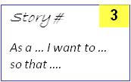
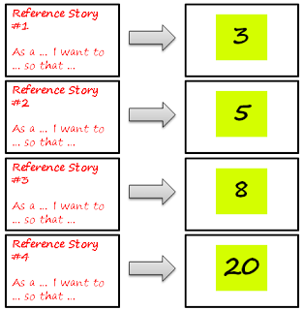

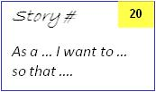
Determining Story Points using DONE stories
Estimation based on and related to known DONE-stories of former Iterations
Get story from the backlog
Select Reference stories
Assign Point

Slide 43
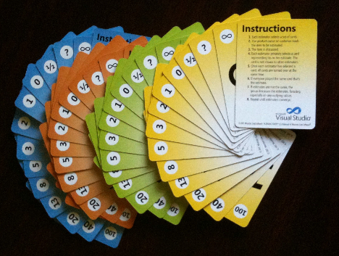
Using Planning Poker as a technique
An iterative approach to estimating
A consensus-based technique for estimating
Used to estimate effort (Ideal Time) or relative size (Story Points) of user stories
Fibonacci sequence including a 0, ½, ?, and ∞ is used for estimation
http://planningpoker.com/
Characteristics
Steps
The whole team estimates
If actual team is not yet selected, then get a typical team to do it, and be sensible: add extra buffer to the final plan
Everyone estimates overall size of the item (not just their part of the work)
Size = effort, complexity, uncertainty
ScrumMaster facilitates (and joins in the estimation if they will be doing work too)
Product Owner should be available to clarify requirements
Each participant gets a deck of estimation cards representing the Fibonacci sequence of numbers
The Moderator/ Product Owner presents one user story at a time to the team
The Product Owner answers any questions the team might have about the story
Each participant privately selects a card representing his or her estimate of the “size” for the user story
When everybody is ready with an estimate, all cards are presented simultaneously
If there is consensus on a particular number then the size is recorded and the team moves to the next story.
Discuss differences (especially outliers)
Re-estimate until estimates converge
Note: Agile teams using Planning Poker tool should ensure that NO requirements data is to be uploaded into the tool as this violates Amex Security and Information management Standards.

Slide 44
Iteration 0
Iteration 0 is conducted at the start of every release to:-
(Re)Validate the core and extended team members
Identify all dependent group signoff need e.g. SAR/PGB, Compliance
Identify the development and test environment
Identify dependencies on other projects, teams & resource that may influence the release schedule
Identify the deliverables and signoff needed
Identify number of Iterations for the release using team velocity (if any)
Identify the schedule for Release Testing and Release Iterations. As a guideline, have release Iteration (Release testing) after every three time boxed development Iterations.
Identify any assumptions made
Identify the risks involved in the project
Detail the project/ release schedule
Create a Release plan

Slide 45
Time-Boxed Development

Slide 46
Envisioning + Time Boxed Development
C
Core + Extended Team
End Users or User Group
Core Team
Iteration Backlog
High Priority groomed work items
Provides Ideas
Part I – User Story Analysis
Part II – Tasking and Task Estimation
PO
Creates Initial Product Backlog
Product Owner/ Chief PO
Backlog Grooming
S
5 – 10% of the Iteration Capacity is dedicated to Continuous Backlog Grooming i.e. Story Analysis, Point Estimation and Splitting stories
PO
Scrum Master
T
Product Owner
Core Team
Extended Team
Core + Extended + Stakeholders
Core Team
Backlog Grooming and Architecture Envisioning
(i.e. Splitting Stories, Point Estimation, Analyzing the Stories, etc)
Product Backlog
Iteration 0
Retrospective
Product Review – Show and Tell
Iteration 1 - n

Slide 47
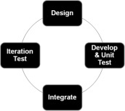
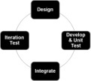


Work Time Available for the team During Iteration
Monday | Tuesday | Wednesday | Thursday | Friday
Iteration Planning
½ Day
15 Min – Daily Standup
15 Min – Daily Standup
1
2
3
15 Min – Daily Standup
15 Min – Daily Standup
15 Min – Daily Standup
15 Min – Daily Standup
15 Min – Daily Standup
4
5
6
7
8
Product Backlog Refinement
½ Day
15 Min – Daily Standup
15 Min – Daily Standup
15 Min – Daily Standup
15 Min – Daily Standup
15 Min – Daily Standup
9
10
11
12
13
15 Min – Daily Standup
15 Min – Daily Standup
14
Show & Tell and Retrospective -
½ Day
15

Slide 48
Burn Down Chart

Slide 49
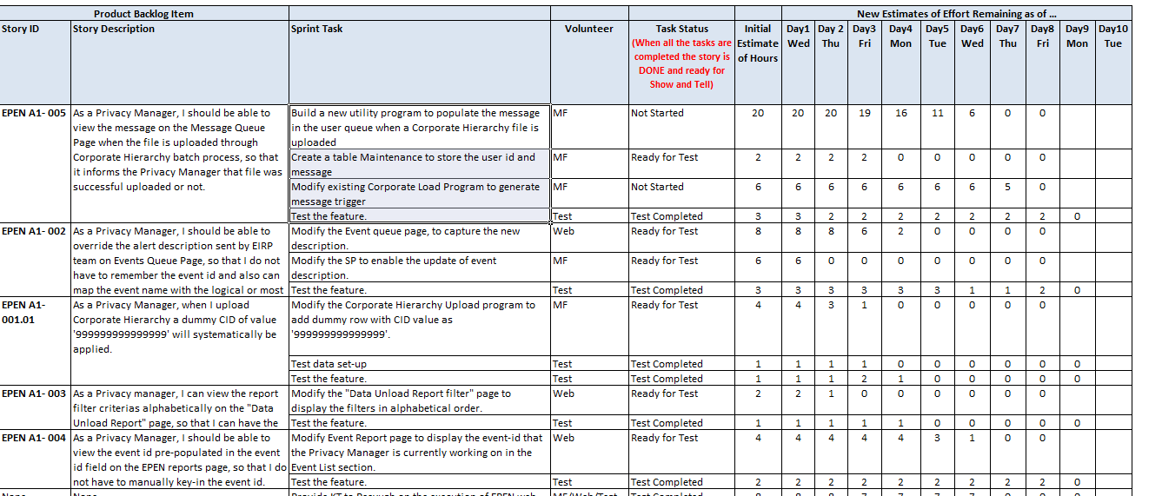
Time Boxed Development - Deliverables
Iteration Backlog
Design (Iteration Backlog, SAD and SID)
Code and Unit Test Scripts/ Test Cases in QC
SIT Test Scripts/ Test Cases in QC
Test Results in QC
Show and Tell
Retrospective

Slide 50
Time Boxed Development – Signoff
Signoff
Iteration Backlog
Show and Tell

Slide 51
Iteration Planning Meeting

Iteration planning meetings have 2 parts that are time-boxed
PART I “WHAT”
Product Owner explains the items at the upper part of the Product Backlog
Team estimates how much they can take on in the Iteration
Team makes a preliminary commitment
PART II “HOW”
Team plans how they are going to implement their commitment
Team starts with design, and this leads to a list of tasks (the Iteration Backlog)
Team confirms their commitment (or adjusts it)

Slide 52
Daily Standup Meeting
Goal
Enable Team to inspect and adapt daily
Enable Team to share progress with each other
Surface what’s blocking or slowing down Team
Team stands in a circle and reports 3 things
What did I do since the last time we met?
What will I try to do by the next time we meet?
What is blocking me (or slowing me down)?
RECOMMENDED No discussion or debate: listening only
RECOMMENDED 15 minutes maximum
RECOMMENDED ScrumMaster notes the blocks (and then later helps Team resolve them)
RECOMMENDED Team and ScrumMaster only – Team can invite PO if they wish, but it’s the Team’s decision

Slide 53
Design Develop Integrate and Test
Design
Design using whiteboard and document only the needed information which will either aid in :-
Developing the product
Maintaining the product
Develop
Pair Programming
Develop using TDD
Integrate
Continuously Integrate
Iteration User Story Acceptance Test
Test the story against the acceptance criteria (Functional test)
Conduct automated regression test
Tip: - Any documents that is either not used for development or not re-used in the future (e.g. for Maintenance) is considered to a waste.

Slide 54
Pair Programming
Code is created by two people working together at a single computer.
Pair programming increases software quality without impacting time to deliver.
Pairing will add as much functionality as two working separately except that it will be much higher in quality.
Recommendation for Pairing
Sit side by side in front of the monitor.
Slide the key board and mouse back and forth.
Both programmers concentrate on the code being written.
Pair programming is not is mentoring.

Slide 55
Test Driven Development
RED
Write a test that fails
Improve the code
TDD
Re-factor
Green
Make the code working
ADVANTAGES
ADVANTAGES
Drives Design – Focusing on test cases first makes the developer think how the functionality will be used
Helps focus on task at hand - helps a developer to really consider what needs to be done
Completed coverage - All written code is covered by at least one test

Slide 56






Continuous Integration
Version Control System
e.g. Subversion
Characteristics
3
Build Servers
Integrate and commit code every few hours
Every one works on the latest version
No changes to obsolete code causing integration nightmare
Integrating continuously and in small amount helps resolve issues as early as possible
Check out
1
Check in
Developers
2
4
Indicate
change
Report Result
6
Notify
5
CI Server
(e.g. Hudson)
Set Status
Testers, Stakeholders
Feedback
Steps
Developers check in the code to Version Control System.
CI Server downloads the source code whenever there is a change in the version control.
Build Servers compiles and inspects the source code, and creates new binaries.
Build server reports the build status to CI Server.
CI Server generates feedback based on the results of the build.
The status of the build is notified to the developers, testers and other stakeholders.

Slide 57
Iteration User Story Acceptance Test
Test the user story functionality against the Story Acceptance Criteria
User story is complete only if the passed its acceptance test
Acceptance test are to be automated enabling to run as often as possible
The Three C’s of a User Story
Card | Conversation | Confirmation
Written on a card/ Product Backlog to have Just Enough Information
Flush out details of the User Story via conversation during Iteration Planning Meeting and during development
Tests and acceptance criteria to determine when a story is complete
Title
Must Have
Acceptance Criteria
View Customer Information
Simulate a call and see if the customer info can be seen of the screen
If the customer info does not exists verify that an error message is displayed on the screen
For incoming call omit the account number and verify error message “No Acc # provided” is displayed on the screen
Description
As a Support Technician, I want: to see customer history on the screen at the start of a call, So that I can better address the customer request.
This
2
Customer Validation

Slide 58
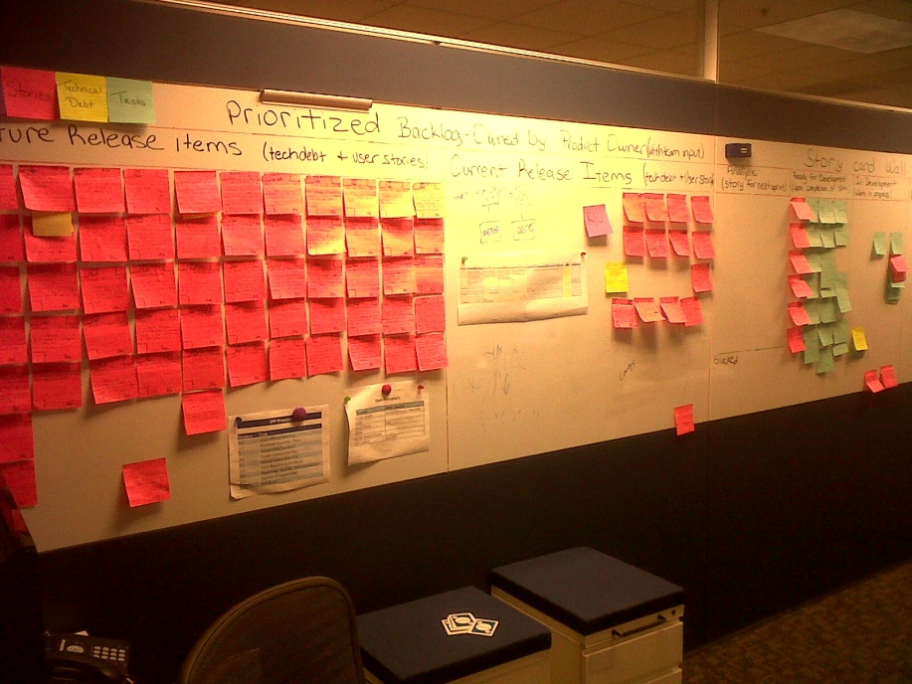
Big Visible Chart or Team information Radiator
Story
Not Started
In Process
To Verify
Done
Iteration Goal: abcdefghijklm
STORY
A
Burndown
Task
1
Task
2
Task
3
2 hrs
24hrs
2 hrs
STORY
B
Task
1
Task
2
Task
3
2 hrs
8 hrs
5 hrs
Not Planned
Next Iteration
STORY
C
Task
1
Task
3
Task
4
Task
3
STORY
C
Task
3
STORY
C
Task
2
5 hrs
STORY
X
STORY
y
2 hrs
8 hrs
8 hrs
Task
x
2 hrs
5 hrs
5 hrs

Slide 59
Release Testing

Slide 60
Envisioning + Time-Box Development + Release Test
C
Core + Extended Team
End Users or User Group
Core Team
Iteration Backlog
High Priority groomed work items
Provides Ideas
Part I – User Story Analysis
Part II – Tasking and Task Estimation
PO
Creates Initial Product Backlog
Product Owner/ Chief PO
Backlog Grooming
S
5 – 10% of the Iteration Capacity is dedicated to Continuous Backlog Grooming i.e. Story Analysis, Point Estimation and Splitting stories
PO
Scrum Master
T
Product Owner
Core Team
Extended Team
Core + Extended + Stakeholders
Core Team
Backlog Grooming and Architecture Envisioning
(i.e. Splitting Stories, Point Estimation, Analyzing the Stories, etc)
Product Backlog
Iteration 0
Retrospective
Product Review – Show and Tell
Iteration 1 - n
Release Testing
Release Testing
Release Testing

Slide 61
Release Testing
Testing carried out as per the test strategy (e.g. UAT, PT, etc)
Types of testing vary from project to project (based on need and as specified in Test Strategy)
Test Cases / Scripts stored in QC

Slide 62
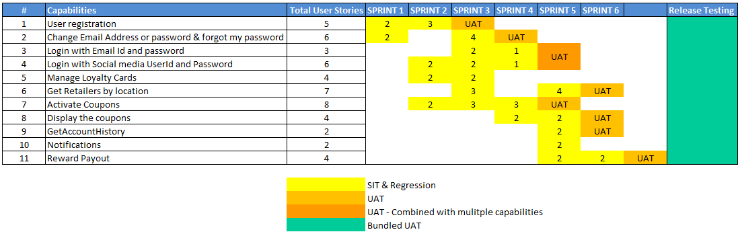
Staggered Release Test or UAT
Business needs to define the capabilities during the release planning.
Based on the capabilities developed as part of Iterations, business needs to execute the UAT in E2 SL.
Dependent Capabilities will account for performing combined Regression and UAT as and when its delivered to the respective environment (E2 SL)
After all the capabilities are tested and developed, E2E to plan for the Release Testing (Bundled UAT)
Below is the proposed approach for Keystone UAT validation:

Slide 63
Release Testing – Sign off
Signoff
Release Test Results (UAT)

Slide 64
Release & Deploy And Warranty & Closure

Slide 65
Release & Deploy And Warranty & Closure
Complete the Project Performance Report
Plan and Prepare for Deployment
Deploy to Production

Slide 66
Release & Deploy And Warranty & Closure – Sign off
Signoff
Project Performance Report (PPR)

Slide 67

Capacity Planning
Capacity planning is the process of determining the production capacity needed by an organization to meet changing demands for its products.
In Scrum Capacity planning, the maximum amount of work that an organization is capable of completing in a given period to build the product.

Slide 68
Capacity Planning
A successful sprint starts with the planning session.
Taking the time to plan allows the team to review the work about to be undertaken, estimate the effort required to complete that work, and then commit to a prioritized list of stories and tasks that are within the team’s calculated capacity.
Agile planning session is to present a collection of user stories to the team and allow them to be estimated. This is where team effort gets aligned with business direction
At the end of the session, the team should feel committed to completing the work required to implement the agreed-upon list of user stories during the next sprint
A well-formed agile team has a product owner who is prepared for the planning session and is ready to present sprint goals and a prioritized list of stories for estimation by the team

Slide 69
Capacity Planning
The product owner should review the product backlog frequently so that stories are staged and ready-to-go for planning sessions based on the latest business priorities product owner who can clearly state the Vision (why the agile team exists) and can formulate clearly the goals for each Sprint.
This clearly stated vision and sprint goals should be used to begin the sprint planning session, so that guiding principles can be applied to each story considered for estimating. New stories are typically unfolded as the team asks questions of the product manager during the planning session.
Two best practices for determining team capacity are:-
-> The total capacity of the team should be based on the following equation:
# of team members × # of days in the iteration × (no more than) six hours
-> suppose a five-member, well-formed agile team is planning a ten-day sprint.
The capacity of the team is quickly established to be
5 members × 10 days × 6 hours per day = 300 hours capacity.
The ideal daily burndown is, therefore, thirty hours (300 hours of capacity ÷ 10 day sprint).

Slide 70
Capacity Planning
Sl. no | User Story Items | Formula | Sample | Actual
A | Number of Developers |  | 4 (Developers)
B | Number of effective hours per day per Team Member |  | 6 (hours per day)
C | Total Hours Per Day for the team | = A*B | 24
D | Sprint Length |  | 10 Days / 2 Weeks
E | Sprint Capacity | = C*D | 240
F | Hours spent in Ceremonies |  | 35 Hours
G | Dedicated time for product support activities based on past history | = % of E | 0 – New Project 8 hours - Existing
H | Dedicated time for any spike (R&D or POC) activities |  | 40 Hours
I | Others (Holidays & Trainings) |  | 10 Days / 80 Hours
J | Development Capacity | = E – [F+G+H+I] | =240-[35+8+40+80] =77 Hours

Slide 71
Capacity Planning – Hours spent in Ceremonies
S. No | Action Items | Formula | Sample | Actual
A | Sprint Planning | = 4 Hours * 4 Developers | 16 Hours
B | Daily Scrum | = 5 Mins * 5 Days | 1.25 Hours
C | Sprint Review | = 2 Hours * 1 Developers | 2 Hours
D | Sprint Retrospective | = 2 Hours * 1 Developers | 2 Hours
E | Product Backlog Refinement | = 4 Hours * 1 Developers | 4 Hours
F | Others |  | 10 Hours
 |  | Total | 35 Hours

Slide 72

Success Stories of Agile

Slide 73
Success Stories of Agile
As we followed the agile approach, we can see the instant changes – identification, implementation, delivery within the budget and on time. This approach is applicable for all the life cycles.
In Scrum model, I have experienced in
Haste Adaptive changes
Helpful to develop Global delivery model in short period of time in effective manner
Instantly gave life to Client Imaginations and fulfilled with the desired vision
As we are the Leaders, we overcome any challenges to deliver the product and gave right direction to our customers on right time
As a Entrepreneurial, customers gave an excellent feedback about our company & our products

Slide 74
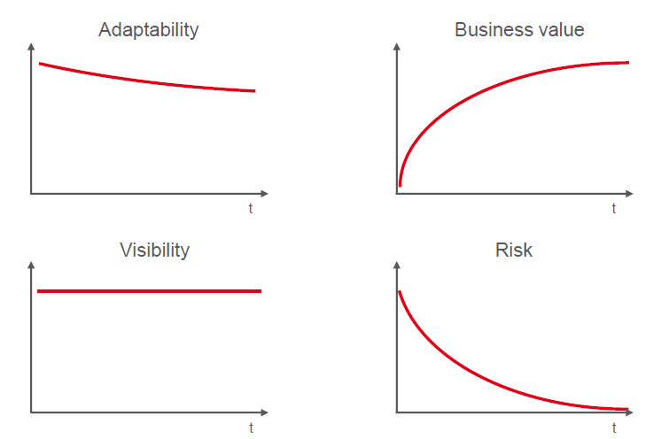
Business Expectations

Slide 75
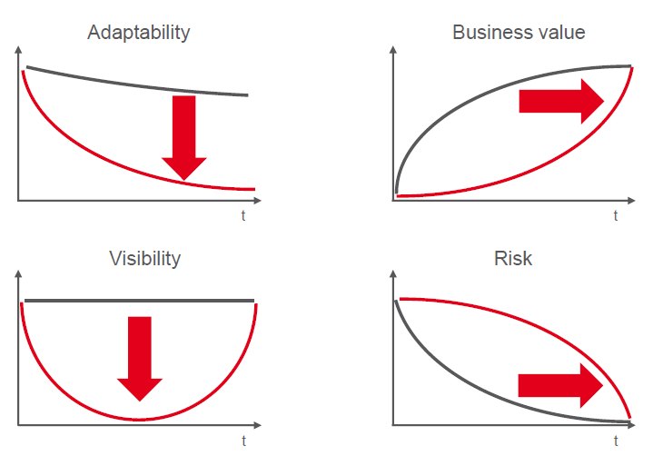
Traditional Project

Slide 76
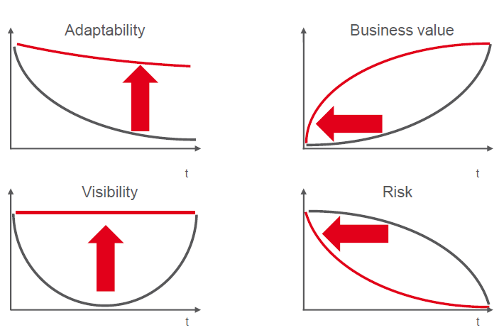
Agile

Slide 77
Success Stories of Agile
Stick to the STANDARD approach
Walk everybody through the standard first, to get an integrated solution, and to get everybody acquainted to the overwhelming existing functions
Show the standard system while gathering requirements don’t wait until the sprint review
Concentrate on Solution based business model and core processes, to avoid modifications
Run all requirements through a Chief architect first
Scrum makes large-scale projects hyper productive
Guide all work towards a clear, compelling business goal
Prioritize by Business Value and Risk

Slide 78
Success Stories of Agile..
Manage against top-level project plan
Don’t blend Scrum with Waterfall
- Assign 1 user-story only to one team member
- Co-locate the team in one room (at least in the beginning)
Use The Wall,
- Public project room promotes open communication Tools are more complex, less transparent, and less fun

Slide 79
Success Stories of Agile..
Scrum makes packaged software implementations
Short sprints (2 weeks) deliver a lot of functionality with standard applications
Work with assumption
Agile projects enable later rework
Allow multiple user stories in parallel into one sprint for standard applications working time is much less than elapsed time
Allow documentation and training to be finished in next sprint standard systems are configured extremely fast

Slide 80
Summary - Success Stories of Agile
Plan enough (up to 30%) contingency in the beginning
Integrate early, additional features can also be added to interfaces later
Implement core process end-to-end first
Start with release sprints (operational readiness test) early, as soon as all standard processes are ready
Gather requirements from the outcome of the process
Implement functions from the start of the process as soon as major prerequisites are in place
Start with Development environment only, others can follow later
Start with test automation from the beginning

Slide 81

Course Completion
Agile
You have successfully completed – Scrum Master course

Slide 82

Questions
“Do or do not…there is no try!”

